Slide 1
Data flow machine architectures
Based on the way of handling data tokens
Data flow computers are divided into
Static model
Dynamic model

Slide 2
static data flow machine
In a static data flow machine data tokens are assumed to move along the arcs of the data flow program graph to the operator nodes.
The nodal operation gets executed when all its operand data are present at the input arcs.
only one token is allowed to exist on any arc at any given time, otherwise the successive sets of tokens cannot be distinguished. This
architecture is considered static because tokens-are not labeled and control tokens
must be used to acknowledge the proper timing in transferring data tokens from
node to node

Slide 3
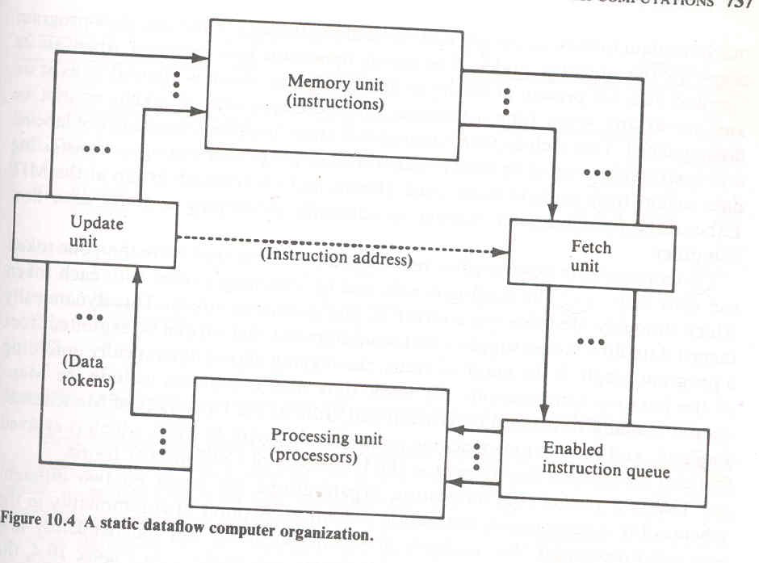

Slide 4
static data flow machine
the data tokens are in the input pool of the update unit. This update unit passes data tokens to their destination instructions in the memory unit.
When an instruction receives all its required operand tokens, it is enabled and forwarded to the enabled queue.
The fetch unit fetches these instructions when they become enabled.

Slide 5
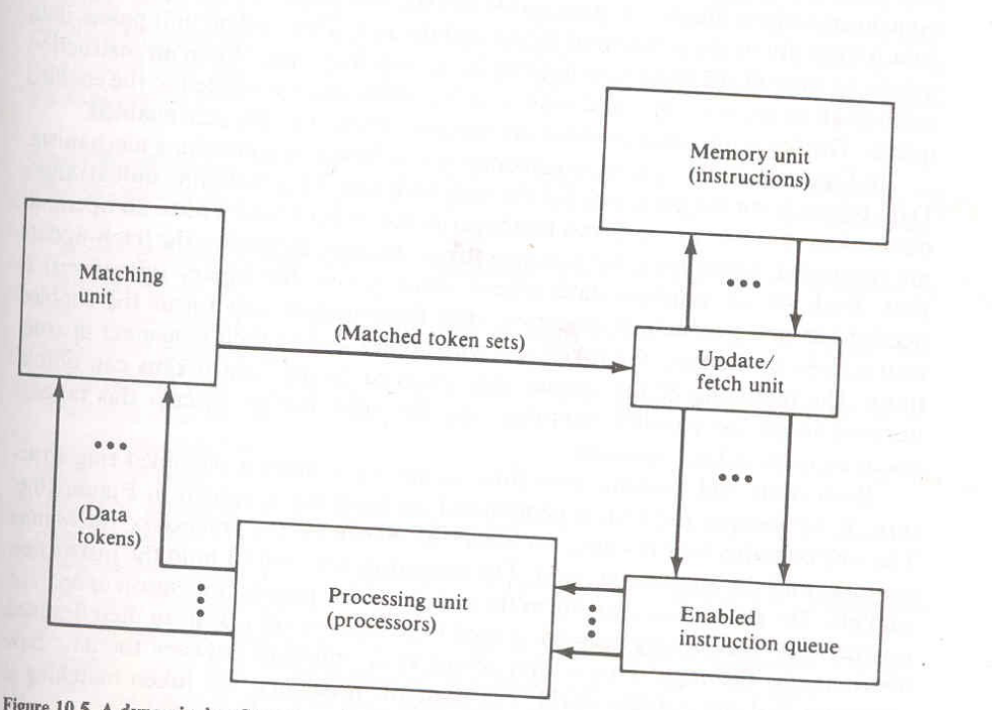
dynamic data flow machine

Slide 6
dynamic data flow machine
In dynamic data flow model, the system synchronization is based on a matching mechanism .
Data tokens form the input pool of the matching unit .This
matching unit arranges data tokens in to pairs or sets and temporarily stores token until all operands are compared, whereupon the matched token sets are released to the fetch-update unit.
Each set of matched data tokens (usually two for binary
operations) is needed for one instruction execution.
The fetch-update unit forms the enabled instructions by merging the token sets with copies sent to their consumer
instructions.
The matching of the special tags attached to the data tokens can unfold iterative loops for parallel computations

Slide 7
Ring-structured dataflow computer organization
Figure 10.6
The ring contains four resource sections:
  The memories
  The processors
  Routing network
  Input-output unit

Slide 8
Ring-structured dataflow computer organization
The memories are used to hold the instruction packets.
The processing units form the task force for parallel execution of enabled instructions.
The routing network is used to pass the result tokens to their destined instructions.
The input-output unit serves as an interface between the data flow computer and the outside world.
For dynamic machines, the token matching is
performed by the I/O section

Slide 9
major design issues in a data flow computer
Page 739

